Slide 1
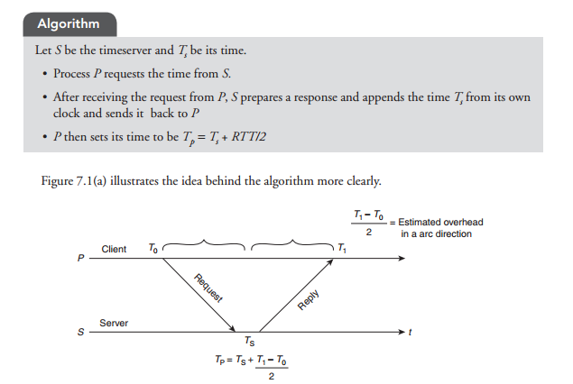

Christian’ Algorithm

Slide 2
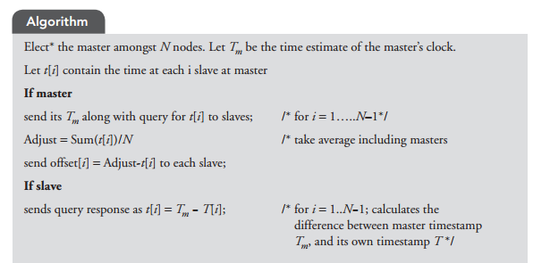
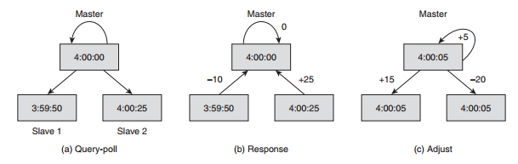
Berkeley’s Algorithm

Slide 3
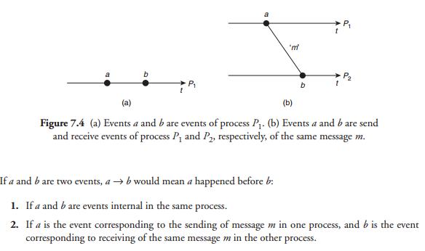
Lamport’s Logical(scalar) Clock

Slide 4
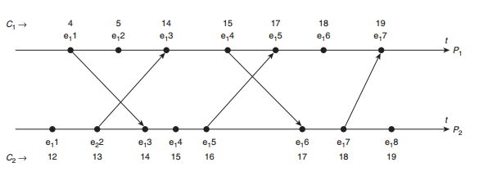
Lamport’s Logical Clock

Slide 5
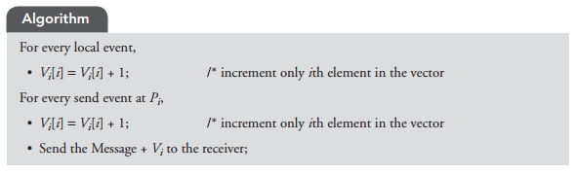
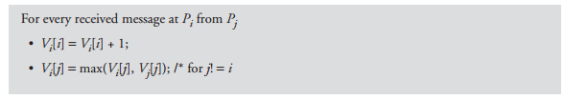
Vector Timestamp Ordering

Slide 6
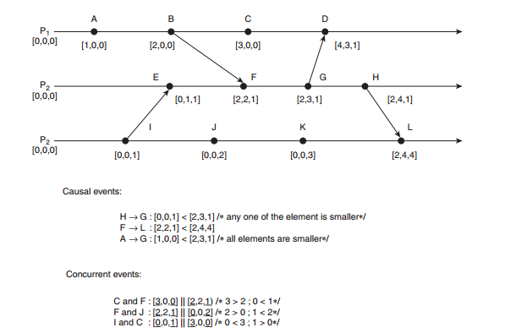
Vector Timestamp Ordering

Slide 7
Coordinator Selection
Election Algorithms

Slide 8
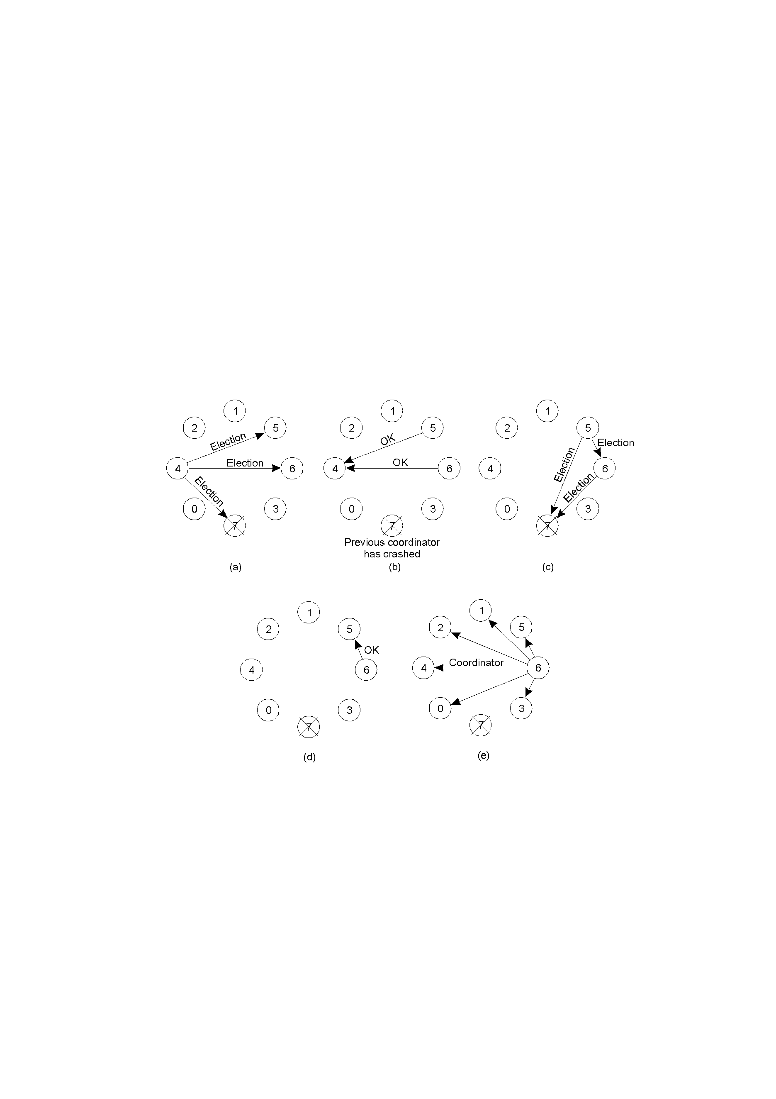
The Bully Algorithm (1)
The bully election algorithm
Process 4 holds an election
Process 5 and 6 respond, telling 4 to stop
Now 5 and 6 each hold an election

Slide 9
Global State (3)
Process 6 tells 5 to stop
Process 6 wins and tells everyone

Slide 10
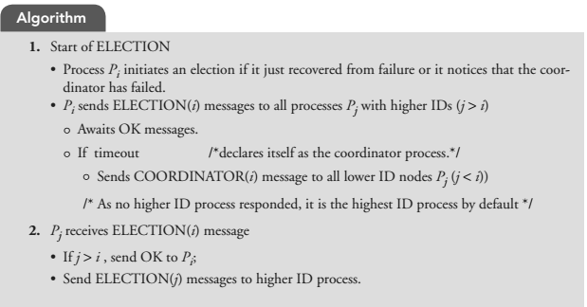
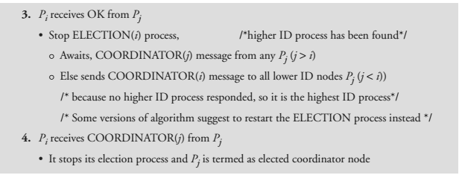

Slide 11
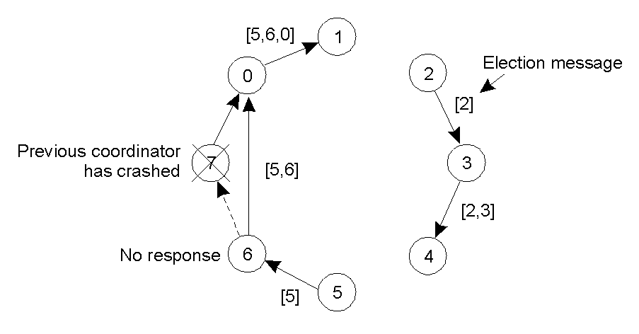
A Ring Algorithm
Election algorithm using a ring.

Slide 12
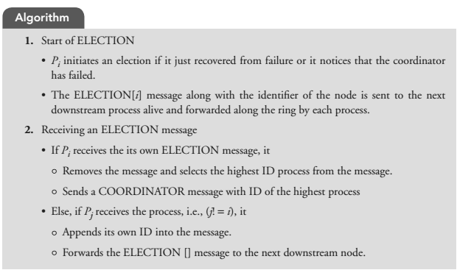
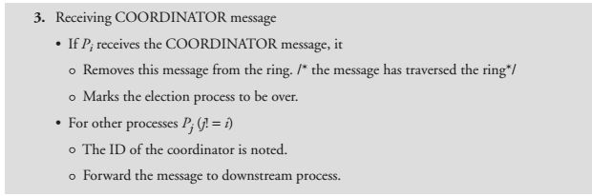

Slide 13
Requirements of Mutual Exclusion Algorithms
1. Safety property: At most one process may execute in the critical region (CR) at a time.
2. Liveness property: A process requesting entry to the CR is eventually granted it. There should not be deadlock and starvation
3. Fairness: Each process should get a fair chance to execute the CR.

Slide 14
Performance Metrics
1. Synchronization delay: Time interval between critical region (CR) exit and new entry by any process.
2. System throughput: Rate at which requests for the CR get executed.
3. Message complexity: Number of messages that are required per CR execution by a process.
4. Response time: Time interval from a request send to its CR execution completed.

Slide 15
Classification of Mutual Exclusion Algorithms
Centralized mutual exclusion algorithms
Distributed mutual exclusion algorithms
Non-token-based algorithm:
  Lamport’s Distributed Mutual Algorithm
  Ricart–Agrawala Algorithm
  Maekawa’s Algorithm
Token-based algorithm:
  Suzuki–Kasami’s Broadcast Algorithm
  Singhal’s Heuristic Algorithm
  Raymond’s Tree-Based Algorithm

Slide 16
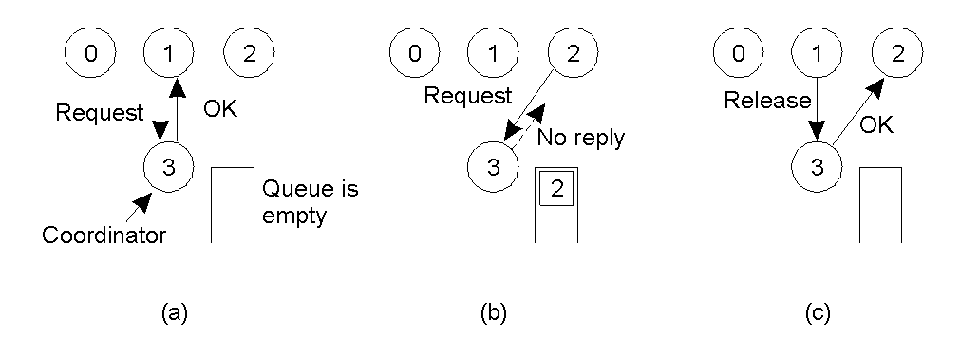
Mutual Exclusion:
A Centralized Algorithm
Process 1 asks the coordinator for permission to enter a critical region. Permission is granted
Process 2 then asks permission to enter the same critical region. The coordinator does not reply.
When process 1 exits the critical region, it tells the coordinator, when then replies to 2

Slide 17
Performance Parameters
1. The algorithm is simple and fair as it handles the request in the sequential order.
2. It guarantees no starvation.
3. It uses three messages as REQUEST, REPLY and RELEASE.
4. It has a single point of failure.
5. Coordinator selection could increase synchronization delay especially at times of frequent failures.

Slide 18
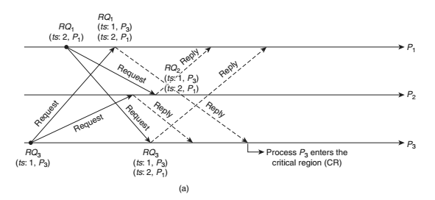
Lamport’s Distributed Mutual Algorithm

Slide 19
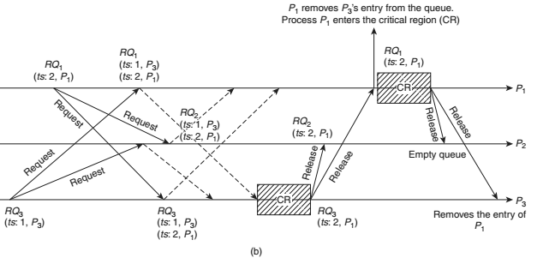

Slide 20
Performance Parameters
Lamport’s algorithm has message overhead of total 3(N − 1) messages: N – 1 REQUEST messages to All process (N minus itself), N −1 REPLY messages, and N −1 RELEASE messages per CR invocation.
The synchronization delay is T. Throughput is 1/(T + E).
The algorithm has been proven to be fair and correct. It can also be optimized by reducing the number of RELEASE messages sent.

Slide 21
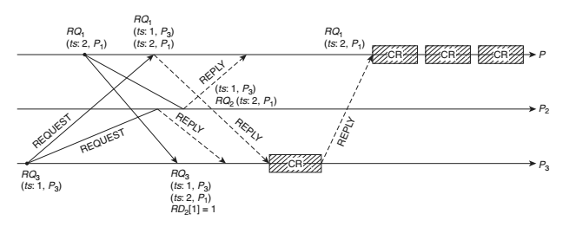
Ricart–Agrawala Algorithm

Slide 22
Performance Parameters
The algorithm does not use explicit RELEASE message. The dequeuing is done on the receipt of REPLY itself. Thus, total message overhead would be 2(N − 1) messages, that is, for entering a CR, (N − 1) requests and exiting (N − 1) replies.
2. The failure of any process almost halts the algorithm (recovery measures are needed) as it requires all replies.

Slide 23
Maekawa’s Algorithm
In previous algo, when process want to enter CR, was sending Request to everyone and could not enter in CR until receipt of Reply from them.
In Maekawas groups are made, called Quorum set
Send request to group members and wait for reply
Quorum set of sites si & sj i.e Ri, Rj such that Ri and Rj will have atleast one common site (Sk). Sk mediates conflicts between Ri and Rj.
A site can send only one REPLY message at a time, i.e., a site can send a REPLY message only after receiving a RELEASE message for the previous REPLY message.
Request Sets Rules:
  Sets Ri and Rj have atleast one common site.
  Si is always in Ri.
  Cardinality of Ri, i.e., the number of sites in Ri is K.

Slide 24
Maekawa’s Algorithm ...
Requesting CS
  Si sends REQUEST(i) to sites in Ri.
  Sj sends REPLY to Si if
    Sj has NOT sent a REPLY message to any site after it received the last RELEASE message.
    Otherwise, queue up Si’s request.
Executing CS: after getting REPLY from all sites in Ri.
Releasing CS
  send RELEASE(i) to all sites in Ri
  Any Sj after receiving RELEASE message, send REPLY message to the next request in queue.
  If queue empty, update status indicating receipt of RELEASE.
Quorum set
Voting based : voted:T/F
Request defered array

Slide 25
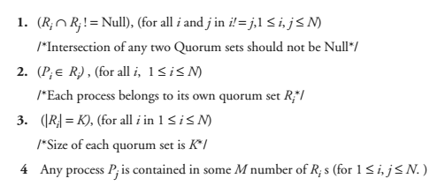
Maekawa’s Algorithm
Properties of a Quorum Set

Slide 26
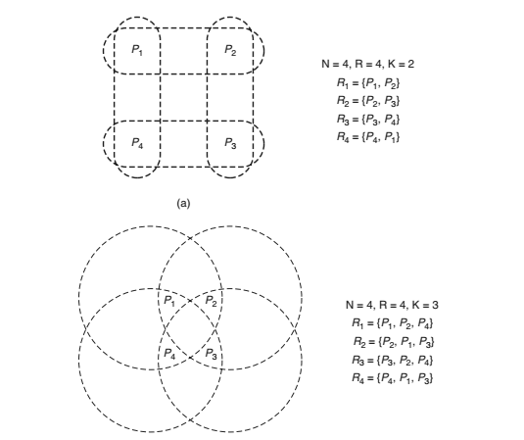

Slide 27
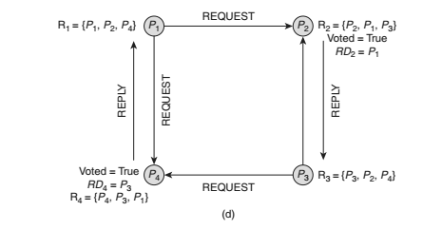

Slide 28
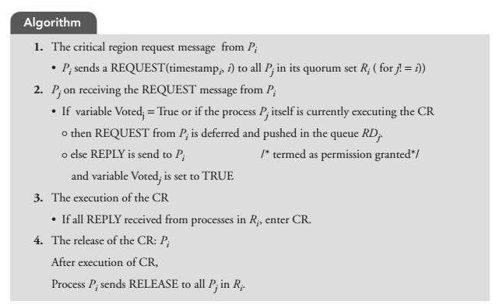
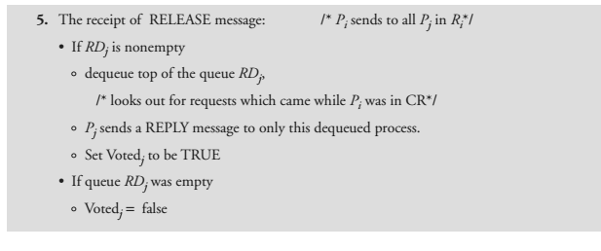

Slide 29
Performance Parameters
1. An execution of the CR requires N REQUEST, N REPLY and N RELEASE messages, thus requiring total 3 N messages per CR execution.
2. Synchronization delay is 2T.
3. M = K = N works best.

Slide 30
REQUEST(i,n) REQUEST(3,4)
i=id of process
n=sequence/request number
1)Request array at process i , Ri[j]
how many times process j has requested for token
R2[3]=5
Ri[j]= max(Ri[j],n) ← REQUEST(j,n)

Slide 31
Token[i]—actually how many times process i executed in CR
Token[1]=6- process 1 executed 6 times in CR
When it will execute in critical region
Token[i]=Ri[i]
Queue: contains process which are requesting for token..

Slide 32
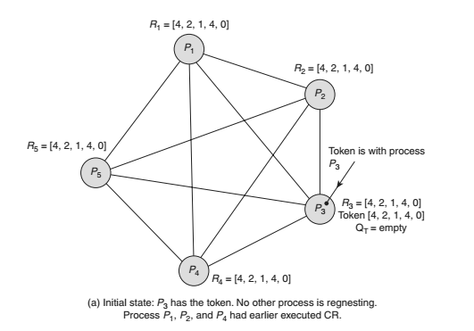
Token-Based Algorithms
Suzuki–Kasami’s Broadcast Algorithm

Slide 33
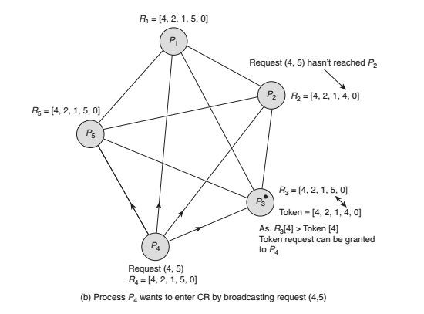

Slide 34
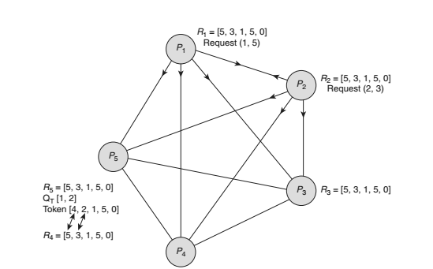

Slide 35
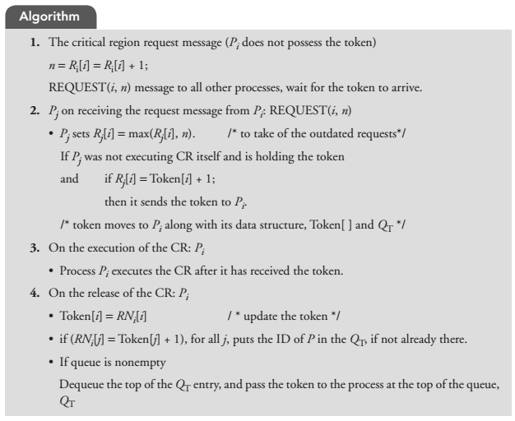

Slide 36
Performance Parameters
1. It is simple and efficient.
2. The algorithm requires at most N messages to obtain the token to enter CR.
3. The synchronization delay in this algorithm is 0 or T. Zero synchronization delay, if the process
already holds the token.

Slide 37
Singhal’s Heuristic Algorithm
1. E = Executing and having the token
2. H = Holding the token and not executing
3. R = Requesting the token
4. N = Neutral, none of the above

Slide 38
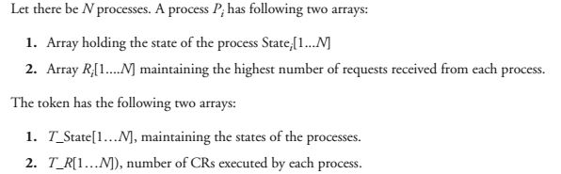
Data Structures

Slide 39
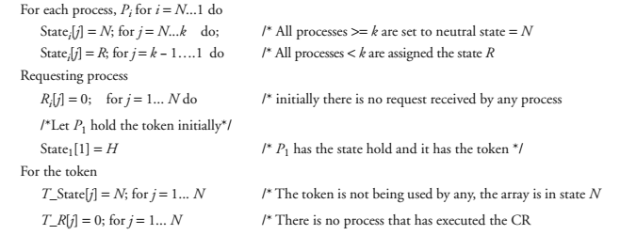
Arrays Initialization

Slide 40
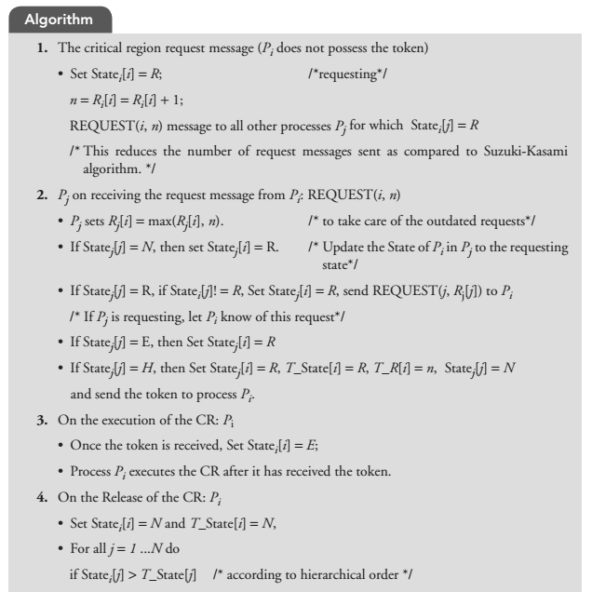

Slide 41
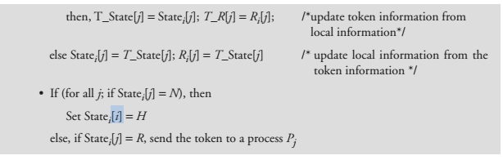

Slide 42
Performance Parameters
Performance Parameters
1. The number of REQUEST messages can vary from N/2 (Average value of the identifier) to N (max value).

Slide 43
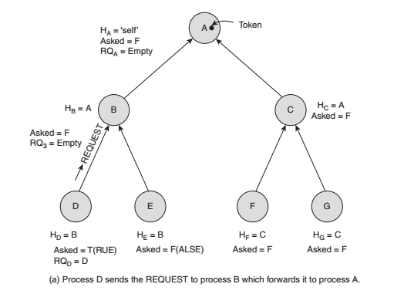
Raymond’s Tree-Based Algorithm

Slide 44
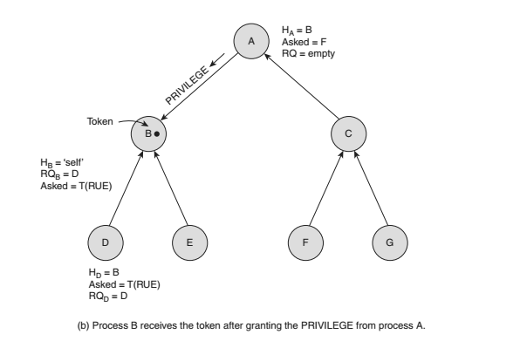

Slide 45
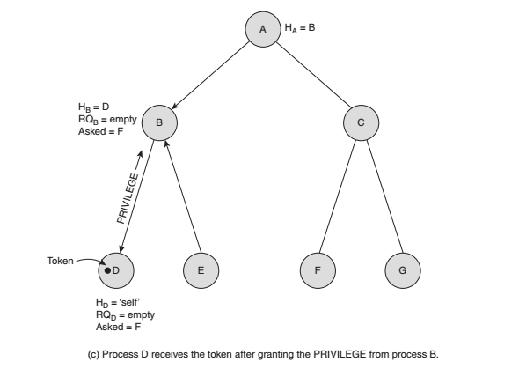

Slide 46
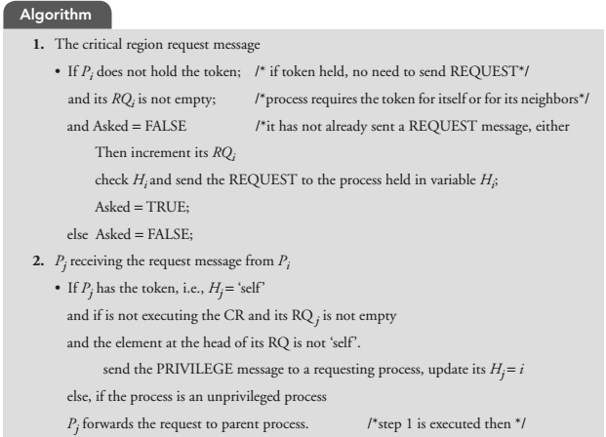

Slide 47
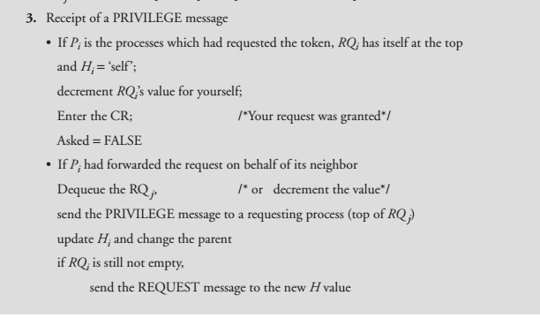

Slide 48
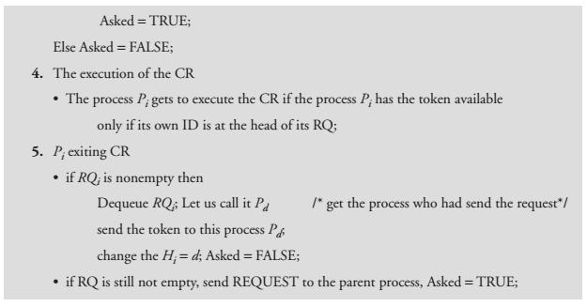

Slide 49
Performance Parameters
The algorithm exchanges only O(log N) messages under light load and four messages under heavy load
to execute the CR, where N is the number of nodes in the network.

